Slide 1
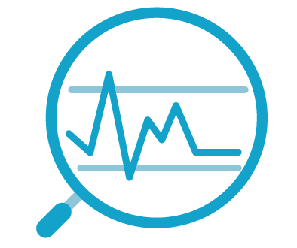
Introduction to Python
IT8701 PDS
Topic 1
Official (Open) Non-Sensitive

Slide 2
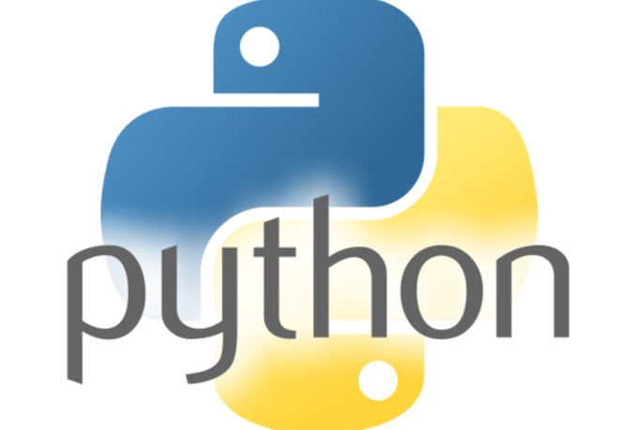
Topics we will cover
Python Basics
Intro to Python
Why Python for Data Science
Install Anaconda Python
Running Python programs with Jupyter Notebook
Running Python programs via command-line
Official (Open) Non-Sensitive

Slide 3
Topics we will cover
Python Basics
Perform simple console input and output in Python
Inserting comments into your Python code
Using import and calling imported functions
Work with simple data types such as numbers, strings
Use assignment, arithmetic, comparison and logical operators
Implement flow control using if-else statements
Implement loop control using for and while statements
Official (Open) Non-Sensitive

Slide 4
Topics we will cover
Python Basics
Use Python list object
Use Python tuple object
Use Python dictionary object
Define Python functions
Perform Python File IO (Input and Output)
Official (Open) Non-Sensitive

Slide 5
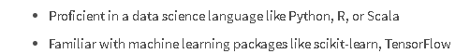

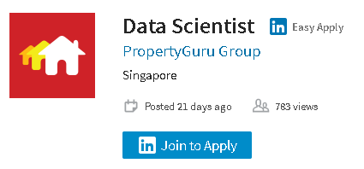


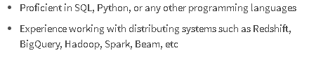
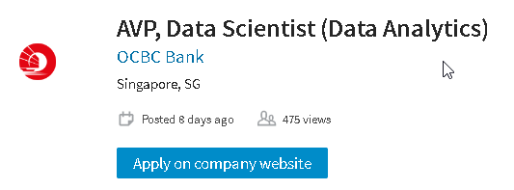
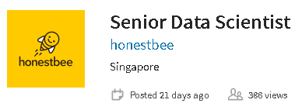
Data Science jobs - what's needed?
Why Programming for Data Science?
https://sg.linkedin.com/jobs/data-science-jobs
Official (Open) Non-Sensitive

Slide 6

Brief History of Python
Introduction to Python
Python is a widely used high-level programming language created by Guido van Rossum and first released in 1991.
Python 2.0 released in Oct 2000, followed by Python 3.0 in 2008
Latest versions of Python
Version 3.7 released in Jun 2018
Version 3.8 released in Oct 2019
Version 3.9 released in Oct 2020
Version 3.10 released in Oct 2021 (current version)
Creator of Python
Official (Open) Non-Sensitive

Slide 7

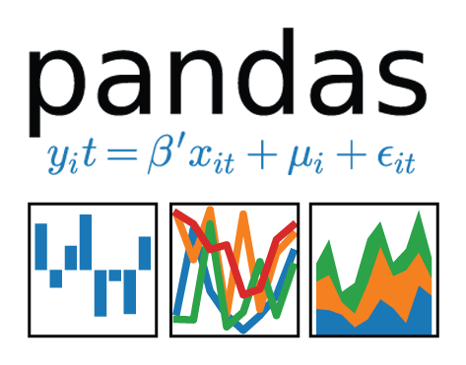
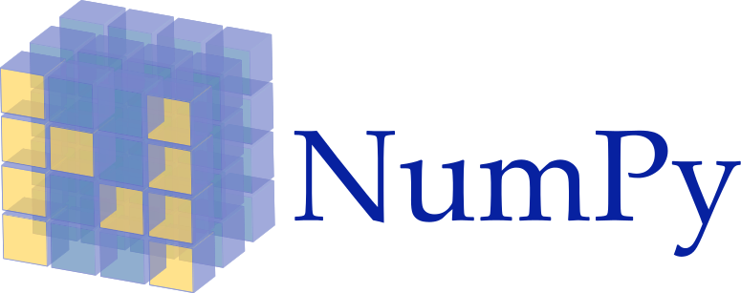
Why Python for Data Science?
Why Python for Data Science?
Python is a great tool for data manipulation, visualization and analysis!
Flexible general programming language
Easy to learn and work with
Has many math / science libraries that makes working with data much easier
Easy to integrate with existing infrastructure such as web server programs already written in Python etc
Official (Open) Non-Sensitive

Slide 8
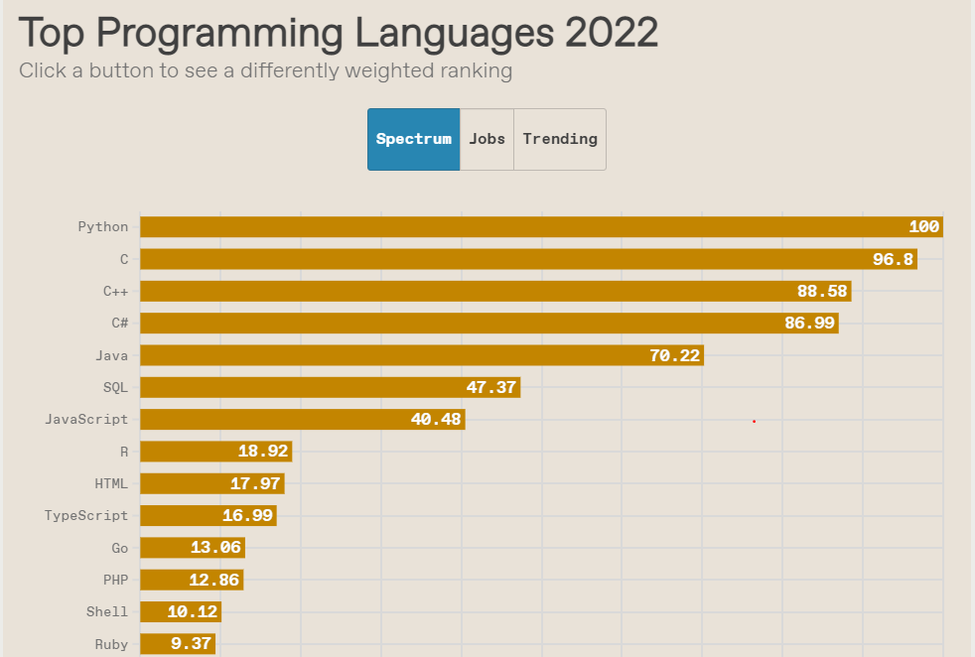
#1 language in 2022
Why Python for Data Science?
Python ranks #1 in IEEE Spectrum 2022
Official (Open) Non-Sensitive

Slide 9
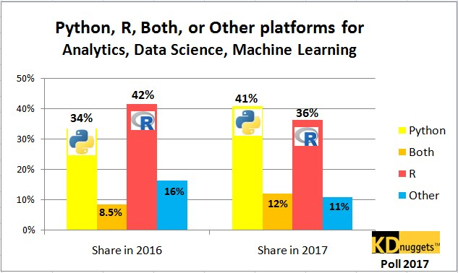
Python overtakes R
Why Python for Data Science?
KDnuggets survey - Python overtook R as the leading platform for Analytics, Data Science, Machine Learning
Top Programming for Data Scientist (2022)
Official (Open) Non-Sensitive

Slide 10
R vs Python
Why Python for Data Science?
R is a language dedicated to statistics. Python is a general-purpose language with statistics modules
R has more statistical analysis features than Python, and specialized syntaxes
However, when it comes to building complex analysis pipelines that mix statistics with other processing features e.g. image analysis, text mining, or control of a physical experiment, the richness of Python is an invaluable asset
Official (Open) Non-Sensitive

Slide 11

Anaconda Python
Install Python for this module
Python can be run on many operating systems : Windows, Linux, Mac etc
For this module, we will install Anaconda 202x that comes with the Python 3.9 distribution
Anaconda is a free Python distribution that comes with most of the data science Python packages we need to write data analysis programs
Includes modules such as NumPy, Pandas, Matplotlib
https://www.anaconda.com/distribution/
Official (Open) Non-Sensitive

Slide 12

Jupyter Notebook
Write and run Python programs with Jupyter Notebook
In this module, you will be largely using the Jupyter Notebook software to write and run your Python code
The Jupyter Notebook App is a web-based application that allows you to edit and run Python programs via your favourite browser.

Slide 13
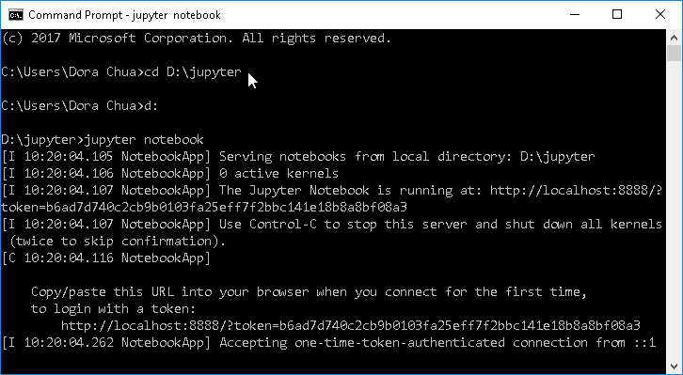
Run Python code via Jupyter Notebook
Write and run Python programs with Jupyter Notebook
Open up a command line console
Change directory to where your Jupyter Notebooks are stored, e.g. cd d:\jupyter
Type jupyter notebook
Official (Open) Non-Sensitive

Slide 14
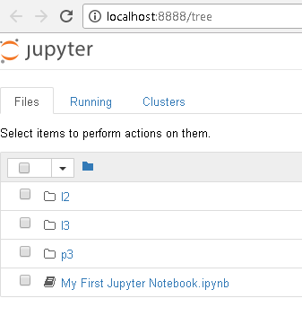
Run Python code via Jupyter Notebook
Write and run Python programs with Jupyter Notebook
Start a new Jupyter Notebook file or click on your existing Jupyter notebook files
Official (Open) Non-Sensitive

Slide 15
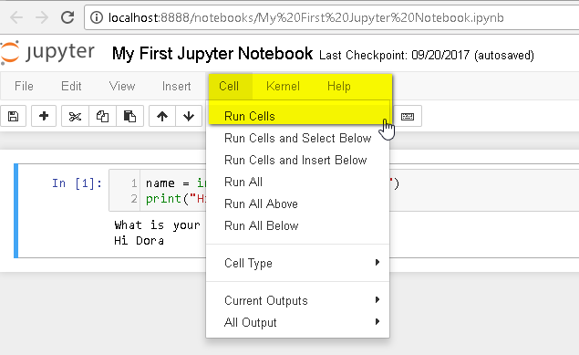
Run Python code via Jupyter Notebook
Write and run Python programs with Jupyter Notebook
Click "Cell->Run Cells"
Official (Open) Non-Sensitive

Slide 16

DEMO
Run Python code via Jupyter Notebook
Official (Open) Non-Sensitive

Slide 17


Text Editor + Command-line
Write and run Python programs with command-line
Python programs can also be written using a plain old text editor such as Notepad and then run via a command-line interface
Some popular and open-source text editors for writing Python code include Sublime Text 3, Visual Studio Code, Notepad++, PyCharm etc
You can also use Spyder that comes with Anaconda
Official (Open) Non-Sensitive

Slide 18
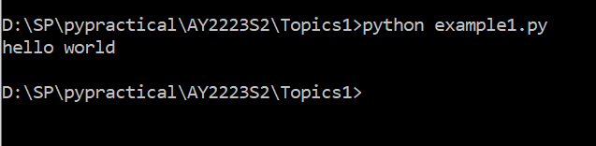
Run Python code via command-line
Write and run Python programs with command-line
Open up a command line console
Change directory to where your Python code is stored, e.g. cd d:\mypythoncode
Type python your_python_file.py
Official (Open) Non-Sensitive

Slide 19
DEMO
Run Python code via command-line
Official (Open) Non-Sensitive

Slide 20
Python Inputs and Outputs (1)
Python Inputs and Outputs
To output to the console, use the print() function
To get input from the console, use the input() function
Ask user for name and print out his name
name = input("What's your name?")
print('Hello' + name)
The input() function automatically interprets all entries as strings
To convert them to numbers, use the int() or float() function
To convert numbers to string, use the str() function
Ask user for length of square and print out area and perimeter
length = int(input("Enter length: "))
breadth = int(input("Enter breadth:"))
print('Area:' + str(length*breadth))
Official (Open) Non-Sensitive

Slide 21

Python Inputs and Outputs (2)
https://docs.python.org/3/library/string.html#formatspec
Python Inputs and Outputs
https://docs.python.org/3/library/string.html#formatstrings
Use the format function to specify decimal precision
weight = float(input("Enter your weight: "))
height = float(input("Enter your height: "))
bmi = weight/(height*height)
print('Your bmi is {} '.format(bmi))
print('Your bmi is {:.2f}'.format(bmi))
print("Your Height is {}, weight is {} and BMI is {:.4f}".format(height,weight, bmi))
Ask user for his weight and height
then calculate and print out his BMI
Official (Open) Non-Sensitive

Slide 22
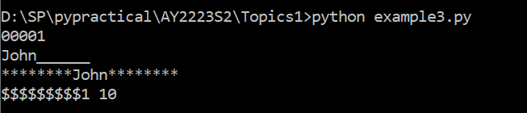
Python Inputs and Outputs (2)
Some Python Basics
Use the format function to specify decimal precision or padding
Example to show how you can pad a string with extra characters, on the right, on the left or in the center
name = ‘John'
num, num2 =1,10
print('{:0>5}'.format(num)) #pad with 5 zeros, right-aligned
print('{:_<10}'.format(name)) #pad with 10 underscores, left-aligned
print('{:*^20}'.format(name)) #pad with 20 asterisks, center-aligned
print('{:$>10} {: <20}'.format(num,num2)) #pad two variables at same time
Official (Open) Non-Sensitive

Slide 23
Python Inputs and Outputs (3)
Python Inputs and Outputs
Use the string interpolation to specify decimal precision. Don’t forget the ‘f’!
weight = float(input("Enter your weight: "))
height = float(input("Enter your height: "))
bmi = weight/(height*height)
print(f'Your bmi is {bmi} ')
print(f'Your bmi is {bmi:.2f}')
print(f"Your Height is {height}, weight is {weight} and BMI is {bmi:.4f}")
Ask user for his weight and height
then calculate and print out his BMI
Official (Open) Non-Sensitive
Notes:
For more on f- String Formatting: https://docs.python.org/3/reference/lexical_analysis.html#f-strings

Slide 24
Inserting comments into Python code
Inserting comments into Python code
Sometimes, you may want to insert comments into your Python code
Start comments with a # symbol
Example to show how you insert comments in Python code
# This example shows you how to write a comment
# The code below prompts the user to enter his current age
# and automatically computes the year he was born
age = int(input('Enter your age this year: '))
year_of_birth = 2018 - age
print("You were born in the year " + str(year_of_birth))
Official (Open) Non-Sensitive

Slide 25
Using import (1)
Import libraries in Python
Sometimes, we need to use a function that is not in the default Python library
To use such functions, we use the import keyword to ask the Python interpreter to let us use it
In the example below, we want to generate a random number using the randint() function from the random module.
So we import the random library
https://docs.python.org/3/tutorial/modules.html
import random
secret_number = random.randint(1,100)
print(secret_number)
Example to show how you can generate random number using the random.randint() function by first importing the random library
Official (Open) Non-Sensitive

Slide 26
Using import (2)
Python Basics
Another example to show how you can get the current time using datetime.now() function which is available only if you import datetime library
# This example shows you how to do an import
# as well as how to format a datetime
# Check out this URL for more datetime formatting options
# https://docs.python.org/3/library/datetime.html#strftime-strptime-behavior
from datetime import datetime now = datetime.now() print('Today is {:%d-%b-%Y %H:%M}'.format(now))
Official (Open) Non-Sensitive

Slide 27
Using import (3)
Import libraries in Python
In the example below, we want to print two messages "Hello" and "Hello again"
However, we want to wait for 5 seconds after the first message, before printing the second
To do this, we can import the sleep function from the time library as shown below
This example shows how delays can be introduced in your program by using sleep() function from time library
from time import sleep
print("Hello")
sleep(5)
print("Hello again")
Official (Open) Non-Sensitive

Slide 28
Using import (4)
Import libraries in Python
Here's another example that uses the time() function from the time library to calculate the time elapsed between two timings
Calculate duration between two times
from time import time
print('Enter your name in the quickest amount of time:')
start = time() # Store the current time
name = input()
reaction_time = time() - start # Calculate how much time has passed
print('You took', reaction_time, ' seconds')
print('You took {:.3f} seconds'.format(reaction_time))
Official (Open) Non-Sensitive

Slide 29
Using import (5)
Import libraries in Python
This example shows how you calculate the number of years, months and days between two dates by using two libraries: datetime and dateutil
from datetime import datetime
from dateutil import relativedelta as rdelta
date_of_birth = "17-08-1973" # in string format
date_of_birth = datetime.strptime(date_of_birth, '%d-%m-%Y') # datetime format
today = datetime.now() # this is in datetime format
# Calculate diff
rd = rdelta.relativedelta(today,date_of_birth)
print("You were born on {:%d-%b-%Y}".format(date_of_birth))
print("{} years, {} months and {} days since you were born".format(rd.years, rd.months, rd.days))
Official (Open) Non-Sensitive

Slide 30
Using import (6)
Import libraries in Python
Python comes with a library of standard modules, some of which are listed here
Modules
Numeric and Mathematical Modules | numbers, math, cmath, decimal, fractions, random, statistics
Functional Programming Modules | itertools, functools, operator
File and Directory Access | pathlib, os.path, fileinput, stat, filecmp, tempfile, glob, shutil
Data Persistence | pickle, copyreg, shelve, dbm, sqlite
Data Compression and Archiving | zlib, gzip, bz2, zipfile, tarfile
File Formats | csv, configparser, xdrlib, plistlib
Cryptographic | hashlib, hmac, secrets
Generic OS services | os, io, time, argparse, getopt, logging, platform
Internet Data Handling | email, json, mimetypes, base64
Internet Protocols and Support | webbrowser, http, ftplib, smtplib, imaplib, telnetlib, ipaddress
Official (Open) Non-Sensitive

Slide 31
Using import (7)
Import libraries in Python
E.g. using the ZipFile from module zipfile to zip up two files in the directory
example_zipfile.py
from zipfile import ZipFile
with ZipFile('spam.zip', 'w') as myzip:
myzip.write('example001.py')
myzip.write('example002.py')
https://docs.python.org/3/library/zipfile.html
Official (Open) Non-Sensitive

Slide 32
Working with numeric data types (1)
Standard Data Types
Python has 3 numeric types: integers (int), floating point numbers (float) and complex numbers
Integers are whole numbers while floating point numbers have decimal points
x = 2
y = 8
z = 3.459
print(x*y) # product of x and y → output: 16
print(x/y) # quotient of x and y → output: 0.25
print(x % y) # remainder of x divided by y → output: 2
print(x**y) # x to the power of y → output: 256
print(round(z,1)) # z rounded to 1 decimal place → output: 3.5
Performing simple arithmetic operations on numeric data types
https://docs.python.org/3.6/library/functions.html#int
Official (Open) Non-Sensitive

Slide 33
Working with numeric data types (2)
Standard Data Types
Besides the standard functions, you can apply several additional mathematical functions from the math library to numeric data types as shown below
Example to show how you use functions from the math library
import math
x = 349.4378
print(math.isnan(x)) # returns True if x is NOT a number
print(math.trunc(x)) # truncate decimal portion of x → output: 349
print(math.ceil(x)) # round x upwards → output: 350
print(math.floor(x)) # round x downwards → output: 349
print(math.sqrt(x)) # square root of x → output: 18.693255468216336
Official (Open) Non-Sensitive

Slide 34
Working with strings
Standard Data Types
Python has a built-in string class with many handy features
String literals can be enclosed by either double or single quotes
Creating string objects
s1 = 'hi how are you'
s2 = "I am fine, thank you"
Official (Open) Non-Sensitive

Slide 35
String indexing
Standard Data Types
Individual characters in a string can be accessed via their INDEX
Indexing starts with zero in Python strings
0 | 1 | 2 | 3 | 4 | 5 | 6 | 7 | 8 | 9 | 10 | 11 | 12 | 13
h | i |  | h | o | w |  | a | r | e |  | y | o | u
s = 'hi how are you'
print(s[0]) # this extracts the character with index 0 → h
print(s[1]) # this extracts the character with index 1 → i
print(s[3:6]) # this extracts 3 characters from index 3 to index 5 → how
Official (Open) Non-Sensitive

Slide 36
Getting length of a string
Standard Data Types
You can retrieve the length of a string with the len function
0 | 1 | 2 | 3 | 4 | 5 | 6 | 7 | 8 | 9 | 10 | 11 | 12 | 13
h | i |  | h | o | w |  | a | r | e |  | y | o | u
s = 'hi how are you'
print(len(s)) # this prints the length of the string → 14
Official (Open) Non-Sensitive

Slide 37
Repeating a string with *
Standard Data Types
You can repeat a string by multiplying it using the * operator
0 | 1 | 2 | 3 | 4 | 5 | 6 | 7 | 8 | 9 | 10 | 11 | 12 | 13
h | i |  | h | o | w |  | a | r | e |  | y | o | u
s = 'hi how are you'
print(s + ' today') # this concatenates the two strings
print(s*2) # prints s twice
Official (Open) Non-Sensitive

Slide 38
Concatenate two strings
Standard Data Types
You can combine two strings by using the + operator
0 | 1 | 2 | 3 | 4 | 5 | 6 | 7 | 8 | 9 | 10 | 11 | 12 | 13
h | i |  | h | o | w |  | a | r | e |  | y | o | u
s1 = 'hi how are you'
s2 = ' today'
print(s1 + s2) # this concatenates the two strings
0 | 1 | 2 | 3 | 4 | 5 | 6 | 7 | 8 | 9 | 10 | 11 | 12 | 13 | 14 | 15 | 16 | 17 | 18 | 19
h | i |  | h | o | w |  | a | r | e |  | y | o | u |  | t | o | d | a | y
Official (Open) Non-Sensitive

Slide 39
Concatenate string and number
Standard Data Types
This example emphasizes the need to use a conversion function when concatenating a string and a non-string
pi = 3.14
#text = 'The value of pi is ' + pi ## This does NOT work
text = 'The value of pi is ' + str(pi) ## This is ok
print(text)
Official (Open) Non-Sensitive

Slide 40
Useful methods of the str class
Standard Data Types
Turn all characters uppercase/ lowercase and check if a string is numeric
s = 'hi how are you'
print(s.upper()) # this prints out the string in CAPS
print(s.lower()) # this prints out the string in lowercase
print(s.isnumeric()) # prints true if s is numeric → returns False
https://docs.python.org/3.6/library/stdtypes.html#str
Official (Open) Non-Sensitive

Slide 41
Useful methods of the str class
Standard Data Types
Find if a substring exists
https://docs.python.org/3.6/library/stdtypes.html#str
0 | 1 | 2 | 3 | 4 | 5 | 6 | 7 | 8 | 9 | 10 | 11 | 12 | 13
h | i |  | h | o | w |  | a | r | e |  | y | o | u
s = 'hi how are you'
print(s.find('ar')) # find 'ar' inside the string and return index if found → returns 7
Official (Open) Non-Sensitive

Slide 42
Useful methods of the str class
Standard Data Types
Splitting a string
https://docs.python.org/3.6/library/stdtypes.html#str
0 | 1 | 2 | 3 | 4 | 5 | 6 | 7 | 8 | 9 | 10 | 11 | 12 | 13
h | i |  | h | o | w |  | a | r | e |  | y | o | u
s = 'hi how are you'
words = s.split(sep=' ') # splits s into an array, using space as separator
print(words[2]) → returns are
words[0]
hi
words[1]
how
words[2]
are
words[3]
you
Official (Open) Non-Sensitive

Slide 43
Types of Operators in Python
Python operators
Python supports the following types of operators:
Arithmetic Operators
Comparison Operators
Assignment Operators
Logical Operators
Membership Operators
Identity Operators
Official (Open) Non-Sensitive

Slide 44
Arithmetic operators
Python Operators
Assume variable num1 holds 10, variable num2 is 5 and variable num3 is 3
+ | Add num1 and num2 | num1 + num2 = 15
– | Subtract num2 from num1 | num1 - num2 = 5
* | Multiply num1 by num2 | num1 * num2 =50
/ | Divide num1 by num2 | num1 / num2 = 2
% | Get the remainder after dividing num1 by num2 | num1 % num2 = 0
** | num1 to the power of num2 | num1 ** num2 = 10⁵
// | Divide num1 by num3 and discard any decimal points from the answer | num1 // num3 = 3
Official (Open) Non-Sensitive

Slide 45
Assignment operators (1)
Python operators
Python allows you to assign single or multiple variables at one go using the = operator
example_assignment_1.py
counter = 100
name = "John" a = b = c = 1
num1,num2,name = 1,2,"john"
print("{c}, {a}, {b}".format(a=name, b=num1, c=num2))
Official (Open) Non-Sensitive

Slide 46
Assignment operators (2)
Python operators
Python also provides compound assignment operators that allow "shortcuts" to add / subtract / multiply / divide
example_assignmentoperators_2.py
a ,b,c,d,e, x = 1, 10, 3, 100, 23, 5
a += x # equivalent to a = a+x, hence, a becomes 6
b -= x # equivalent to b = b-x, hence, b becomes 5
c *= x # equivalent to c = c times x, hence,c becomes 15
d /= x # equivalent to d = d divide by x, hence,d becomes 20.0
e %= x # equivalent to e = remainder of e divide by x, hence,e becomes 3
Official (Open) Non-Sensitive

Slide 47
Comparison operators
Python Operators
Assume variable num1 holds 10, variable num2 is 20
num1=10
num2=20
print(num1==num2)
print(num1!=num2)
== | num1 == num2 | False
!= | num1 != num2 | True
> | num1 > num2 | False
< | num1 < num2 | True
>= | num1 >= num2 | False
<= | num1 <= num2 | True
Official (Open) Non-Sensitive

Slide 48
Logical operators
Python Operators
Assume variable num1 =10, variable num2 = 20, name1="Dora", name2="Bryan"
and | num1>=10 and num2>=10 num1>=20 and num2>=20 | True False
or | len(name1)>=5 or len(name2)>=5 len(name1)>=6 or len(name2)>=6 | True False
not | not num1==num2 not num1<num2 | True False
example_logicaloperators_1.py
Official (Open) Non-Sensitive

Slide 49
Membership operators
Python Operators
Python’s membership operators test for membership in a sequence, such as strings, lists, or tuples.
example_membershipoperators_1.py
a = 5
b = 10
list = [1, 2, 3, 4, 5 ]
print(a in list) # True
print(b in list) # False
print(b not in list) # True
Official (Open) Non-Sensitive

Slide 50
Identity operators
Python Operators
example_identityoperators_1.py
Identity operators compare the memory locations of two objects.
a = 20
b = 20
c = a
d= 30
print( a is b) # True
print(a is not b) # False
print(a is c) # True
print(b is c) # True print(a is d) # False
Official (Open) Non-Sensitive

Slide 51
If-else statements (1)
Flow control - if else statements
Python provides if-else statements to enable conditional programming
input_1 = int(input("Enter number 1:"))
input_2 = int(input("Enter number 2:"))
if input_1==input_2:
print("The two numbers are the same")
else:
print("The two numbers are not the same")
Check if two numbers are equa
Official (Open) Non-Sensitive

Slide 52
If-else statements (2)
Flow control - if else statements
Python provides if-else statements to enable conditional programming
input_1 = input("Enter number 1:")
input_2 = input("Enter number 2:")
if input_1.isnumeric() and input_2.isnumeric() :
num_1 = int(input_1)
num_2 = int(input_2)
sum = num_1 + num_2
print("The sum of {} and {} is {}".format(num_1,num_2,sum))
else:
print("Please enter numeric values only")
example_ifelse_1.py
Official (Open) Non-Sensitive

Slide 53
elif
Flow control - if else statements
You can also add in an unlimited number of elif statements following an if to check for multiple conditions
example_ifelse_2.py
print("Below is our drinks menu:")
print("1.Coke 2.Coffee 3.Juice")
drink = int(input("Enter your choice of drink:"))
if drink==1:
print("Coke is $1.00")
elif drink==2:
print("Coffee is $0.50")
elif drink==3:
print("Juice is $2.00")
else:
print("Sorry, you have entered an invalid choice")
Official (Open) Non-Sensitive

Slide 54
Nested if-else
Flow control - if else statements
number = input("Enter your choice (1-2): ")
staff = input("Are you a staff (Y/N)? ")
if number=="1":
if staff.upper() == "Y":
price = 5*0.9
else:
price = 5*0.95
elif number=="2":
if staff.upper() == "Y":
price = 10*0.8
else:
price = 10
else:
print("You did not enter a valid input")
exit()
print("Price is ${}".format(price))
You can also nest if-else and elif statements
Official (Open) Non-Sensitive

Slide 55
iteration with for and while loops
Loops
We often want computers to repeat some process several times
Programming languages provide structures that enable you to repeat blocks of instructions over and over again
This type of repetition is known as iteration.
There are 2 types of loops in Python:
for loop
while loop
These simple for loop and while loop examples would write "hello world" 5 times:
for counter in range(0,5):
print("hello world")
counter = 0
while counter < 5:
print("hello world")
counter+=1
Official (Open) Non-Sensitive

Slide 56
Using for loop
Loop control - for and while statements
Use the for loop when you know how many times you want to repeat a series of statements
The first line of the for statement is used to state how many times the code should be repeated
A stepper variable is used to count through each iteration of the loop.
Syntax
for stepper_variable in sequence_variable
something_you_want_to_do
This prints Line 1, Line 2, Line 3 etc until Line 20
for i in range(1,21): print("Line {}".format(i))
This prints even numbers from 2 to 100
This prints the individual letters in the word Python
for i in range(2,102,2): print(i)
for letter in 'Python': # First Example
print('Current Letter :', letter)
Official (Open) Non-Sensitive

Slide 57
while loop (1)
Loop control - for and while statements
The while loop repeatedly executes as long as a given condition is true.
This prints "The count is 1", "The count is 2" etc until 10
count = 1
while count <= 10:
print('The count is: {}'.format(count))
count += 1
print("Good bye!")
Official (Open) Non-Sensitive

Slide 58
while loop (2)
Loop control - for and while statements
password = ""
while password != "secret":
password = input("Please enter the password: ")
if password == "secret":
print("Thank you. You have entered the correct password")
else:
print("Sorry the value entered in incorrect - try again")
Here is an example of a while loop being used to test a password. The password is secret and the code within the loop is executed until the user inputs the correct password.
Official (Open) Non-Sensitive

Slide 59
while loop (3)
Loop control - for and while statements
invalid = True
while invalid:
number = int(input("Please enter a number in the range 10 to 20: "))
if number >= 10 and number <= 20:
invalid = False
else:
print("Sorry number must be between 10 and 20")
print("Please try again")
print("You entered {}".format(number))
print("This is a valid number")
Here is another example showing a boolean variable being used to control the loop. This is very common with while loops. In this case, the boolean variable is named Invalid. Invalid is initially set to be True. The code within the loop is executed until Invalid is set to False. This is a good method for validating any input that needs to be within a certain range.
Official (Open) Non-Sensitive

Slide 60
while loop (4)
Loop control - for and while statements
This is a high-or-low guessing game that keeps repeating until the user guesses the right answer. The loop is broken with the keyword break
import random rand_number = random.randint(1, 1000) # generate a number for user to guess
while True:
input1 = int(input("Enter your guess (1 to 1000)"))
if input1 == rand_number:
print("You are right!")
break;
elif input1 < rand_number:
print("Your guess is too low")
elif input1> rand_number:
print("Your guess is too high")
Official (Open) Non-Sensitive

Slide 61
Python Lists
Sequence Data Types - Python Lists
The Python list class is used to store collections of similar or dissimilar items
Creating a list is as simple as putting different comma-separated values between square brackets
Similar to string indices, list indices start at 0, and lists can be sliced, concatenated and so on.
not_a_list = 'red'
list1 = ['red', 'green', 'blue']
list2 = ['NSDDA1', 'NSDDA2', 2017, 2018]
list3 = [1, 2, 3, 4, 5 ]
list4 = ["a", "b", "c", "d"]
Official (Open) Non-Sensitive

Slide 62
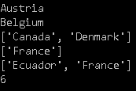
Accessing Values in Lists (1)
Sequence Data Types - Python Lists
To access values in lists, use the square brackets for slicing along with the index or indices to obtain value available at that index
You can get the length of a Python list by using the len() function
countries = ['Austria', 'Belgium', 'Canada', 'Denmark', 'Ecuador', 'France']
print(countries[0]) ## Austria
print(countries[1]) ## Belgium
print(countries[2:4]) ## Canada, Denmark
print(countries[-1:]) ## France
print(countries[-2:]) ## Ecuador, France
print(len(countries)) ## 6
Official (Open) Non-Sensitive

Slide 63
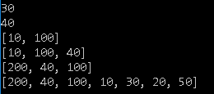
Accessing Values in Lists (2)
Sequence Data Types - Python Lists
Another example to show how you can "slice" lists
list1 = [50,20,30,10,100,40,200]
print(list1[2]) # 3rd element from the front -> 30
print(list1[-2]) # 2nd element from the back -> 40
print(list1[3:5]) # 4th to 5th element -> 10 100
print(list1[-4:-1]) #10 100 40
print(list1[-1:-4:-1]) #200 40 100
print(list1[::-1]) #200 40 100 ...
Official (Open) Non-Sensitive

Slide 64

Iterate through a List (1)
Sequence Data Types - Python Lists
You can use the for loop to iterate through a Python list
colors = ['red', 'green', 'blue', 'yellow', 'magenta', 'cyan']
for color in colors:
print(color)
numbers = [1,2,3,4,5,6,7,8,9,10]
for n in numbers
print(n) # 1,2,3,4,5,6,7,8,9,10
Official (Open) Non-Sensitive

Slide 65
Iterate through a List (2)
Sequence Data Types - Python Lists
colors = ["red car", "green car", "blue", "purple"]
cars = ["Toyota", "Mercedes"]
for i in range(len(colors)):
print(colors[i])
fruits = ['banana', 'apple', 'mango','pear','grape']
for index in range(2,5):
print('Current fruit :', fruits[index]) #mango, pear, grape
Official (Open) Non-Sensitive

Slide 66
Updating Lists
Sequence Data Types - Python Lists
subjects = ['English','Maths','Geography']
## add new item at the back
subjects.append("Physics")
## insert new item at the front
subjects.insert(0, "Chem")
## update value at index 0
subjects[0] = "Chemistry"
## remove at index 1
del(subjects[1])
## removes the last object
subjects.pop()
You can update a list element by giving the slice on the left-hand side of the assignment operator
To add elements in a list, use append() or insert() methods
To remove elements in a list, use del() or pop() methods
Official (Open) Non-Sensitive

Slide 67

+ and * operations on Lists
Sequence Data Types - Python Lists
list_1 = [50,20,30,10,100,40,200]
list_2 = [300,65,80]
list_3 = ["apple", "orange","pear"]
print(list_1 + list_2)
print()
print(list_3*2)
print()
Lists respond to the + and * operators much like strings, equating to concatenation (+) and repetition (*) as well
The result is a new list
Official (Open) Non-Sensitive

Slide 68

Built-in List Functions
Sequence Data Types - Python Lists
Python includes the following list functions
mylist = [50,20,30,10,100,40,200]
mytuple = (50,20,30,10,100,40,100)
print(len(mylist))
print(max(mylist))
print(min(mylist))
print(list(mytuple))
Function | Description
len(list) | Gives total length of the list
max(list) | returns item with the max value from the list
min(list) | returns item with minimum value from the list
list(seq) | Converts tuple from the list
Official (Open) Non-Sensitive

Slide 69
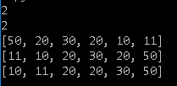
Built-in List Methods
Sequence Data Types - Python Lists
Python includes the following list methods
list1 = [50,20,30,20]
print(list1.count(20))
print(list1.index(30))
list1.extend([10,11])
print(list1)
list1.reverse()
print(list1)
list1.sort()
print(list1)
Function | Description
count(obj) | Returns count of how many times obj occurs in listGives total length of the list
extend(seq) | Appends the contents of seq to list
index(obj) | Returns the lowest index in list that obj appears
reverse() | Reverses objects of list in place
sort([func]) | Sorts objects of list, use compare func if given

Slide 70

Copying lists
Sequence Data Types - Python Lists
Make a copy of a list to another list
Changes to the copy do not affect the original
list1 = [50,20,30,10,100,40,200]
list1copy = list(list1)
list1copy.sort()
print(list1) # list remains the same
print(list1copy) # listcopy is now sorted
Official (Open) Non-Sensitive

Slide 71
List Comprehensions (ADVANCED)
Sequence Data Types - Python Lists
Python supports a concept called "list comprehensions"
It eliminates need for loops and makes code very concise
It is an advanced concept, so don't worry too much about it if its a little hard to grasp
S = [x**2 for x in range(10)]
print(S) #0 1 4 9 16 25 36 49 64 81
col = ['Red','Green','Blue','Yellow']
info = [[c.upper(), c.lower(), len(c)] for c in col]
print(info)
Official (Open) Non-Sensitive

Slide 72
Working with tuples (1)
Sequence Data Types
A tuple is like a list. The difference is that, it is immutable (cannot be changed)
Tuples use round brackers instead of square brackets
tup1 = ('physics', 'chemistry', 1997, 2000);
tup2 = (1, 2, 3, 4, 5 );
tup3 = "a", "b", "c", "d";
tup4 = (50,) # for tuples with a single value, it is a must to put a comma after first value
print(tup1)
print(tup2[2:4])
print(tup3[-1])
print(len(tup4))
example_tuples_1.py
Official (Open) Non-Sensitive

Slide 73
Introduction to Functions
Python functions
A function is a block of organized, reusable code that is used to perform a single, related action
Functions provide better modularity for your application and a high degree of code reusing
# The familiar print() function
print("Hello")
# The familiar input() function
num1 = input("Enter number 1: ")
num2 = input("Enter number 2: ")
# The familiar len() function
name = input("Enter your name: ")
print(len(name))
Official (Open) Non-Sensitive

Slide 74
Defining a Python function
Python functions
An example of a user-defined function
Python gives you many built-in functions like print(), input() etc
In addition, you can also create your own functions
These functions are called user-defined functions.
def printme(str, num_times):
for i in range(num_times):
print(str)
printme('Hello',3)
printme('*****',2)
Official (Open) Non-Sensitive

Slide 75
Defining a Python function
Python functions
Function blocks begin with the keyword def followed by the function name and round brackets
The round brackets may enclose input parameters
The code block within every function starts with a colon (:) and is indented
A function may optionally return None, one, or more return values
def printme(str, num_times):
for i in range(num_times):
print(str)
This function accepts two input parameters
Does not return any value
printme('Hello',3)
printme('*****',2)
Official (Open) Non-Sensitive

Slide 76
Defining a Python function
Python functions
from time import sleep
def printme(str, num_times,delay):
for i in range(num_times):
print(str)
sleep(delay)
printme('Hello',10,5)
printme('*****',20,3)
This function accepts thtree input parameters
Does not return any value
Official (Open) Non-Sensitive

Slide 77
Defining a Python function
Python functions
def traffic_light(color):
if color == 'red':
return "Cannot cross"
elif color == 'green':
return "Can cross"
else:
return "Invalid color"
color = "red"
print(traffic_light(color))
color = "green"
print(traffic_light(color))
This function accepts one input parameter
Returns a single string value
Official (Open) Non-Sensitive

Slide 78
Defining a Python function
Python functions
def isDivisibleBy(num1,num2):
if num1 % num2 == 0:
return True
else
return False
n1 = 180
n2 = 4
print(isDivisiblyBy(n1,n2))
This function accepts two input parameters
Returns a single Boolean value
Official (Open) Non-Sensitive

Slide 79

Defining a Python function
Python functions
def divideList(list, number):
list1 = []
list2 = []
for n in list:
if n<number:
list1.append(n)
elif n> number:
list2.append(n)
return list1, list2
This function accepts two input parameters, first is a list, second is a number
The function iterates through the list elements, and divides up the list
First list -> numbers smaller than number
Second list -> numbers greater than number
Returns both the First and Second List
d = [100,5,11,30,35,16] d1, d2 = divideList(d,20)
print(d1) print(d2)
Official (Open) Non-Sensitive

Slide 80
Built-in modules vs Custom modules
Writing and using your own Python modules
In an earlier sub-topic, you learnt how you can utilise functions from the Python standard library by using the import keyword
Besides using the built-in Python modules, you can also create your own custom Python module to implement a set of functions which you want to isolate and allow re-use
Custom modules in Python are simply Python files with the .py extension
import random
secret_number = random.randint(1,100)
print(secret_number)
Official (Open) Non-Sensitive
Notes:
https://www.learnpython.org/en/Modules_and_Packagesqw2

Slide 81
Write and use your own Python module
Writing and using your own Python modules
Writing Python modules is very simple
To create a module of your own, simply create a new .py file with the module name
Import it using the Python file name (without the .py extension) using the import command
import random
def secret_number():
return random.randint(1,100)
mysecretnumber.py
import mysecretnumber
print(secret_number())
Official (Open) Non-Sensitive

Slide 82
End of Topic 1
Official (Open) Non-Sensitive

Slide 83
Some useful Python resources
Links
https://docs.python.org/3/library/
https://docs.python.org/3/tutorial

Slide 84
Some useful Python resources
Links
https://www.tutorialspoint.com/python
http://www.practicepython.org/
https://www.learnpython.org
https://www.w3resource.com/python/python-tutorial.php
https://pythonschool.net/
https://developers.google.com/edu/python/
https://chrisalbon.com/python
http://pbpython.com/
www.pythonforbeginners.com
https://www.programiz.com/python-programming
pythoncentral.io
https://learnpythonthehardway.org
http://codingbat.com/python

Slide 85
Some useful Python resources
Links
https://stackoverflow.com/questions/tagged/python
https://pyformat.info/

